Slide 1
FOOD VALUE on Your Click
Najmudin (WQD170036)
Md Monir (WQD170043)
Atul (WQD170029)

Slide 2
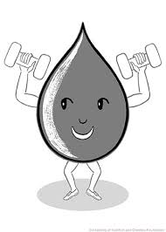
Nutrients and Sources
Balanced Nutrients
Diet Leads to a Healthy
Lifestyle with enhanced
Longevity and disease prevention

Slide 3
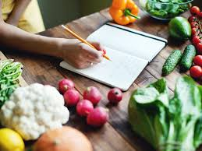
Motivation: Calculate the Healthy Nutrients Count with Ease

Slide 4
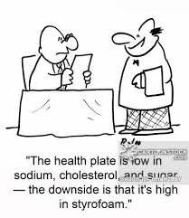
Motivation: Cut down elements like Cholesterol, Sugar & Sodium

Slide 5
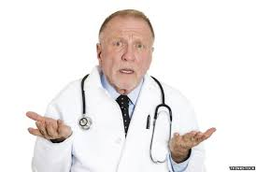
Doctor’s Day Out
Increasing levels of Stress
Junk food intake
fast paced Factors
Lack of Balanced Diet
Missing important nutrients like Iron, Magnesium, Protein, Selenium and Vitamins
Not avoiding foods which are having excess of Sugar, Sodium and Cholesterol

Slide 6

Lack of Balanced Nutrient Rich Diet leads to Over Medication

Slide 7
Aim:Create a innovative application for Positive & Negative Nutrients Count
Created a Shiny r application.
Facts: Besides taking medication for varied diseases, people have to take Food Supplements in the form of medication.
Our application gives the count of essential minerals and vitamins along with the respective Foods chosen.
Along with giving in the details of elements which we need to avoid in excess(Cholesterol, sodium, sugar).

Slide 8
Our Dataset: USDA National Nutrients Database for Standard Reference
Complete list of composition of Raw, Processed and Prepared Foods
Like: Baked products, Beef products, Breakfast Cereals, Cereal Grains and Pasta, Eggs, Fast Foods, Legumes & Legumes products, Side Dishes, Nut & Seed products, Pork products, Poultry products, Snacks, Soups, Sauces & Gravies, Vegetable & Vegetable products.

Slide 9
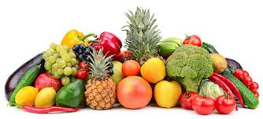
Our Dataset explained: Nutritional Value present in varied foods
Water, Energy, Protein, Lipid, Carbohydrate, Fibres, Sugars, Iron, Magnesium, Phosphorus, Potassium, Sodium, Zinc, Copper etc.

Slide 10
Application Usage
Choose one type of Food and two types of Essential Nutrients on the left side, the result will be displayed in the form of two Bar Graphs on the right side,
Similarly, anyone can also check for two types of negative elements(Cholesterol, Sugar & Sodium) which one needs to avoid in excess

Slide 11
ADVANTAGES
World would be a much safer, better, lively and Healthy place if we know what types of food we need to take for ourselves
What type of food we need to avoid to stay away from the diseases and thus remain protected.

Slide 12
Data Source Beltsville Human Nutrition Research Ccenter
https://www.ars.usda.gov/northeast-area/beltsville-md/beltsville-human-nutrition-research-center/nutrient-data-laboratory/docs/sr28-download-files/

Slide 13
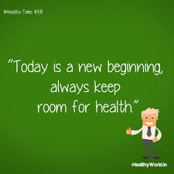
THANK YOU SO MUCH

